Slide 1

HTML Tags Session3
LIST
Lecturer : Ms.Lavanya Mohan
Email :lavanya@metaverseage.ae

Slide 2
Proper Nesting
CODE:
<p><i>Call for a free quote for your web development needs:
<strong>888.555.5555 </strong></i></p>
BROWSER DISPLAY:
Call for a free quote for your web development needs: 888.555.5555

Slide 3
HTML Lists
Unordered List
Ordered List
Description List (formerly called a definition list)

Slide 4
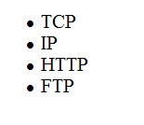
Unordered List
Displays a bullet, or list marker, before each entry in the list.
<ul> Contains the unordered list
<li> Contains an item in the list
</li>
</ul>

Slide 5
Unordered List Example
<ul>
<li>TCP</li>
<li>IP</li>
<li>HTTP</li>
<li>FTP</li>
</ul>

Slide 6
Nested unorder List
<ul> <li>Coffee</li> <li>Tea <ul> <li>Black tea</li> <li>Green tea</li> </ul> </li> <li>Milk</li> </ul>

Slide 7

style="list-style-type:square;"

Slide 8
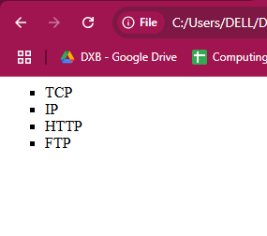
Code
Output
<html>
<body>
<ul style="list-style-type:square;">
<li>TCP</li>
<li>IP</li>
<li>HTTP</li>
<li>FTP</li>
</ul>
</body>
</html>

Slide 9
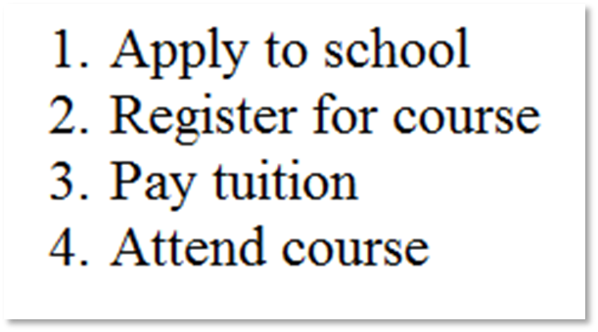
Ordered List
Displays a numbering or lettering system to itemize the information contained in the list
<ol> Contains the ordered list
type attribute determines numbering scheme of list, default is numerals
<li> Contains an item in the list

Slide 10
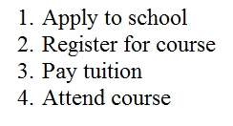
Ordered List Example
<ol>
<li>Apply to school</li>
<li>Register for course</li>
<li>Pay tuition</li>
<li>Attend course</li>
</ol>

Slide 11
Type | Description
type="1" | The list items will be numbered with numbers (default)
type="A" | The list items will be numbered with uppercase letters
type="a" | The list items will be numbered with lowercase letters
type="I" | The list items will be numbered with uppercase roman numbers
type="i" | The list items will be numbered with lowercase roman numbers
<ol>
<li>Bharathan</li>
<li>pradeep</li>
<li>jinu<li>
</ol>
<ol type=“1”>

Slide 12
Control List Counting
<ol start="50"> <li>Coffee</li> <li>Tea</li> <li>Milk</li> </ol>

Slide 13
Nested HTML Lists
<ol> <li>Coffee</li> <li>Tea <ol> <li>Black tea</li> <li>Green tea</li> </ol> </li> <li>Milk</li> </ol>

Slide 14
Description List
Useful to display a list of terms and descriptions or a list of FAQ and answers
<dl> Contains the description list
<dt> Contains a term/phrase/sentence Configures empty space above and below the text
<dd> Contains a description of the term/phrase/sentence
Indents the text
Configures empty space above and below the text

Slide 15
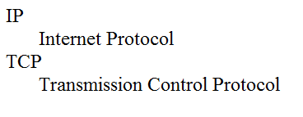
Description List Example
<dl>
<dt>IP</dt>
<dd>Internet Protocol</dd>
<dt>TCP</dt>
<dd>Transmission Control Protocol</dd>
</dl>

Slide 16
Exercise
https://www.w3schools.com/html/exercise.asp?filename=exercise_html_lists2

Slide 17
Thank You

